Slide 1
CSE 212 Final Presentation
Vimal Vinod, Tim Sullivan, Dean Zambrotta
Notes:
Tim

Slide 2
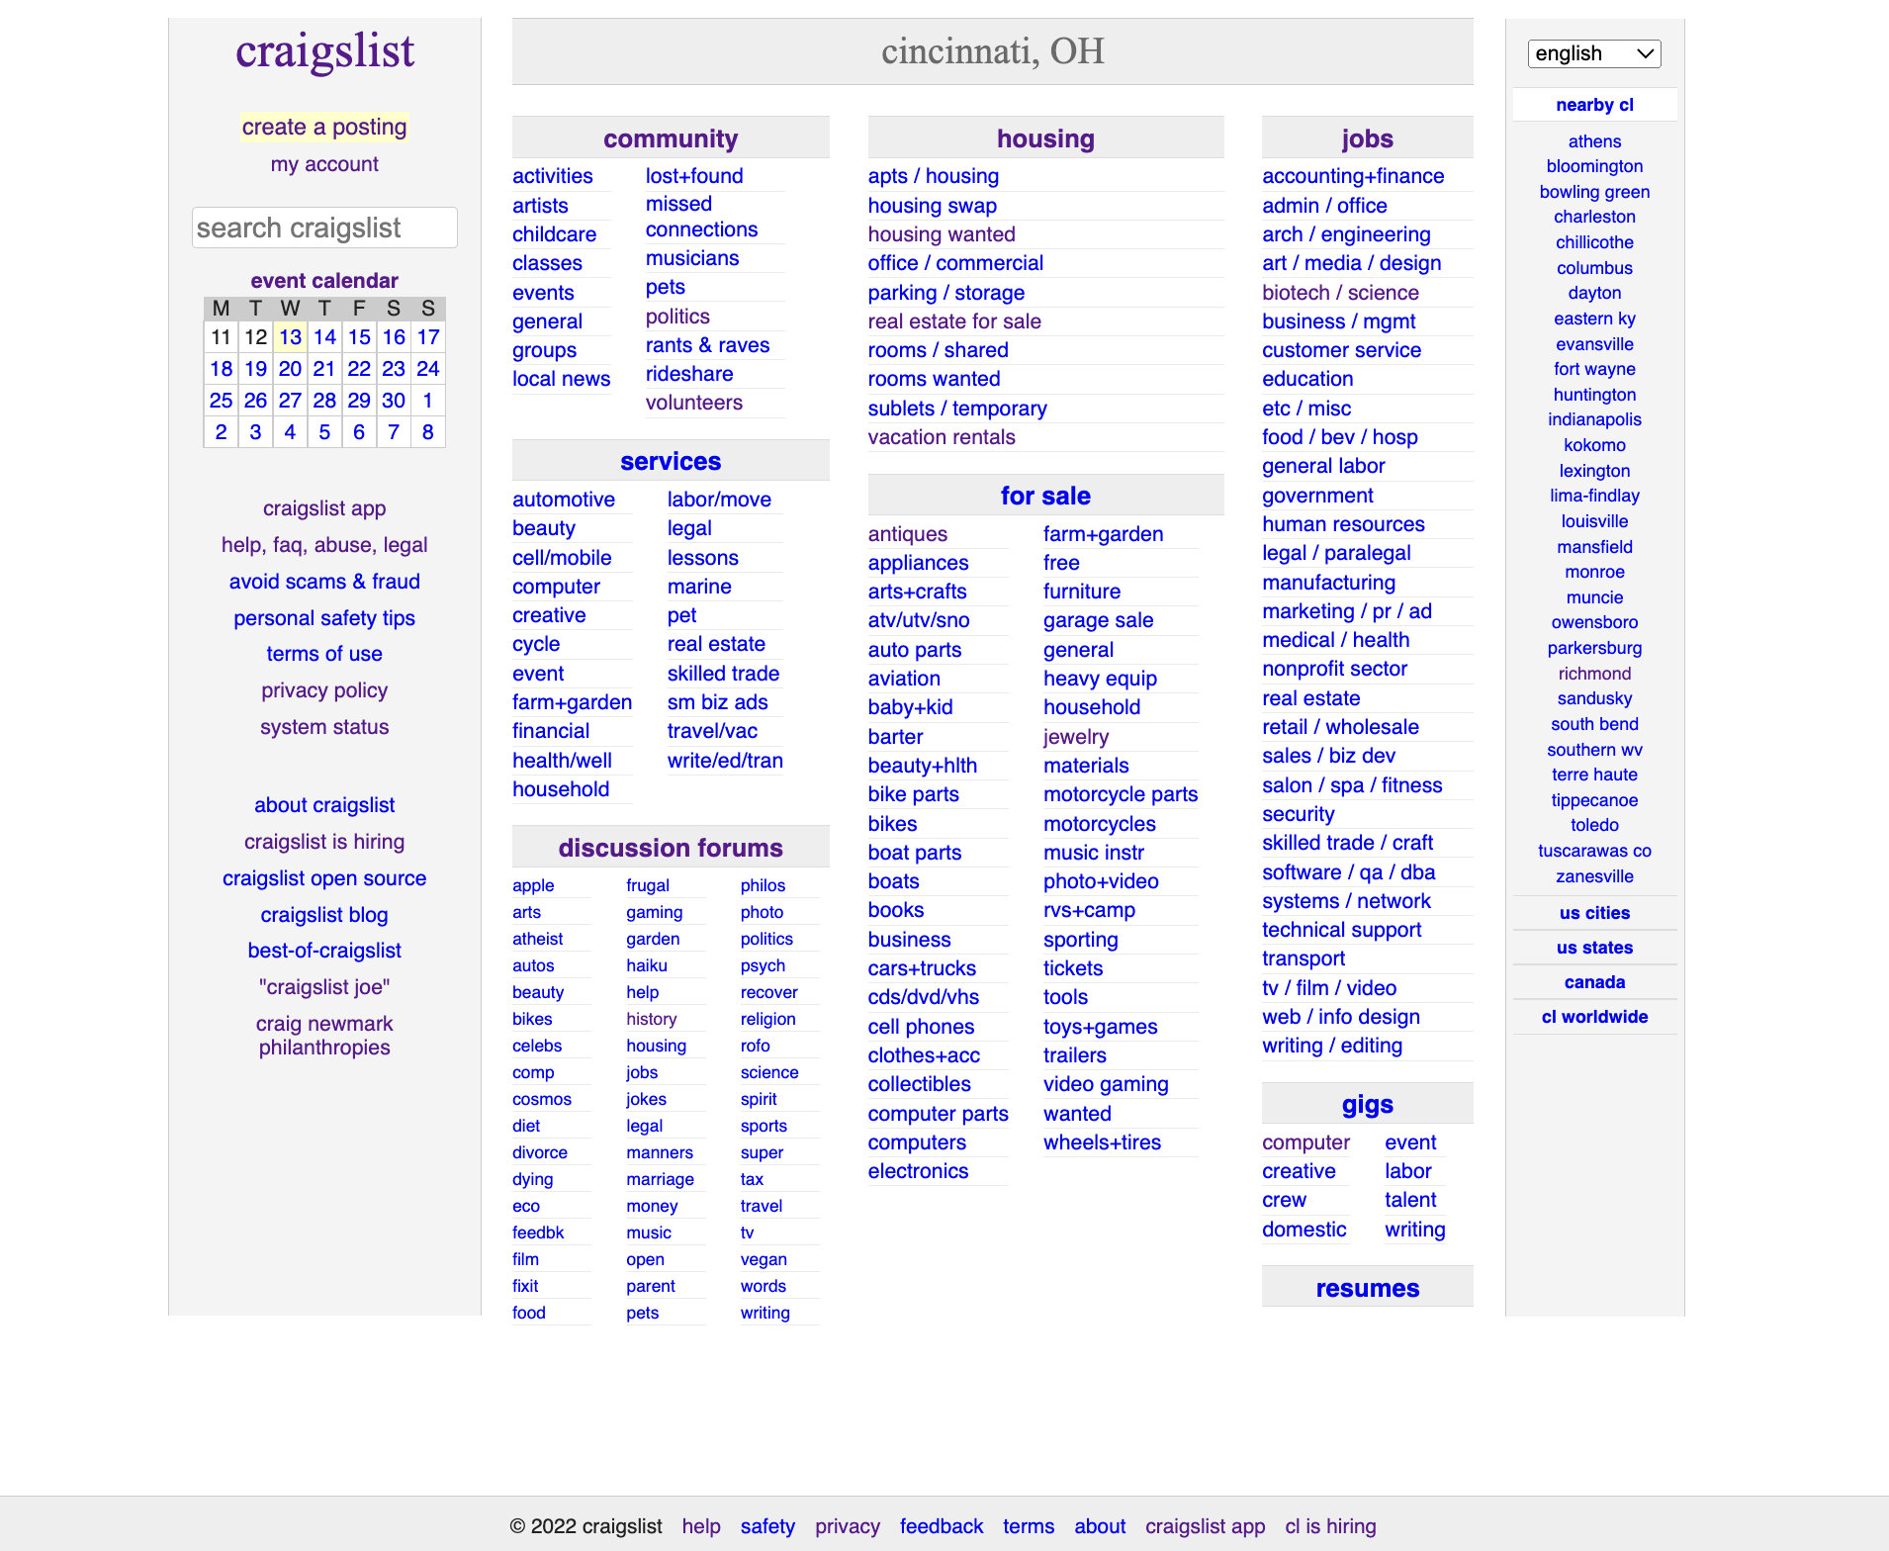
Description of System
The user interface of “craigslist.com” looks like something a person from the 1990s or early 2000s designed and never updated.
This was the biggest reason why we chose to redesign this system. The Craigslist website is made up primarily of links.
Majority of screen composed of links
Notes:
Tim

Slide 3
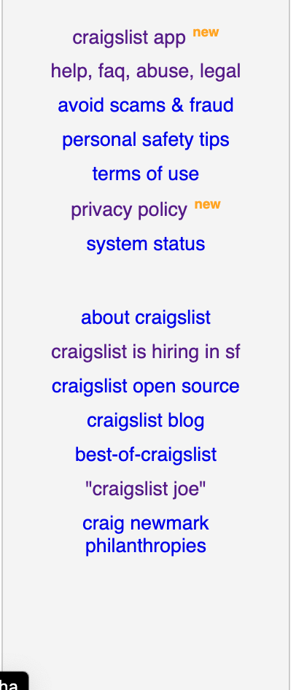
The System - craigslist.com
Redundant links on the left-hand and bottom-hand sides of the system
Clunky line of links to move over to nearby cities
“craigslist joe” - A link to a 2012 documentary about craigslist
“craig newmark philanthropies” - Another irrelevant link
Notes:
Tim

Slide 4
Users - User Profile
We created two user profiles in our project
The first kind were:
12-25 and male or female
May be able bodied or disabled
May have some education (up to college)
Very motivated
Tech literate
The second kind were:
40-80+ and male or female
May be able bodied or disabled
May have some education
Could be motivated
Tech illiterate
Notes:
Tim

Slide 5
User Persona Example
Technology Proficiency:
Everyday use of computers
Confident with technology
Motivator and Frustrations (Pain Points):
Long wait times
Bad cell services
Personal Hobbies:
Working out
Blogging about his experience in the logistics world
Aspirations and Goals:
To become a manager in the logistics division of his company
Age: 24
Marital Status: Not married
Occupation: Logistics Salesman
Education: College - Undergraduate Degree
Hobbies: Working out, Watching the Office, Hiking, and traveling the world
Notes:
Tim

Slide 6
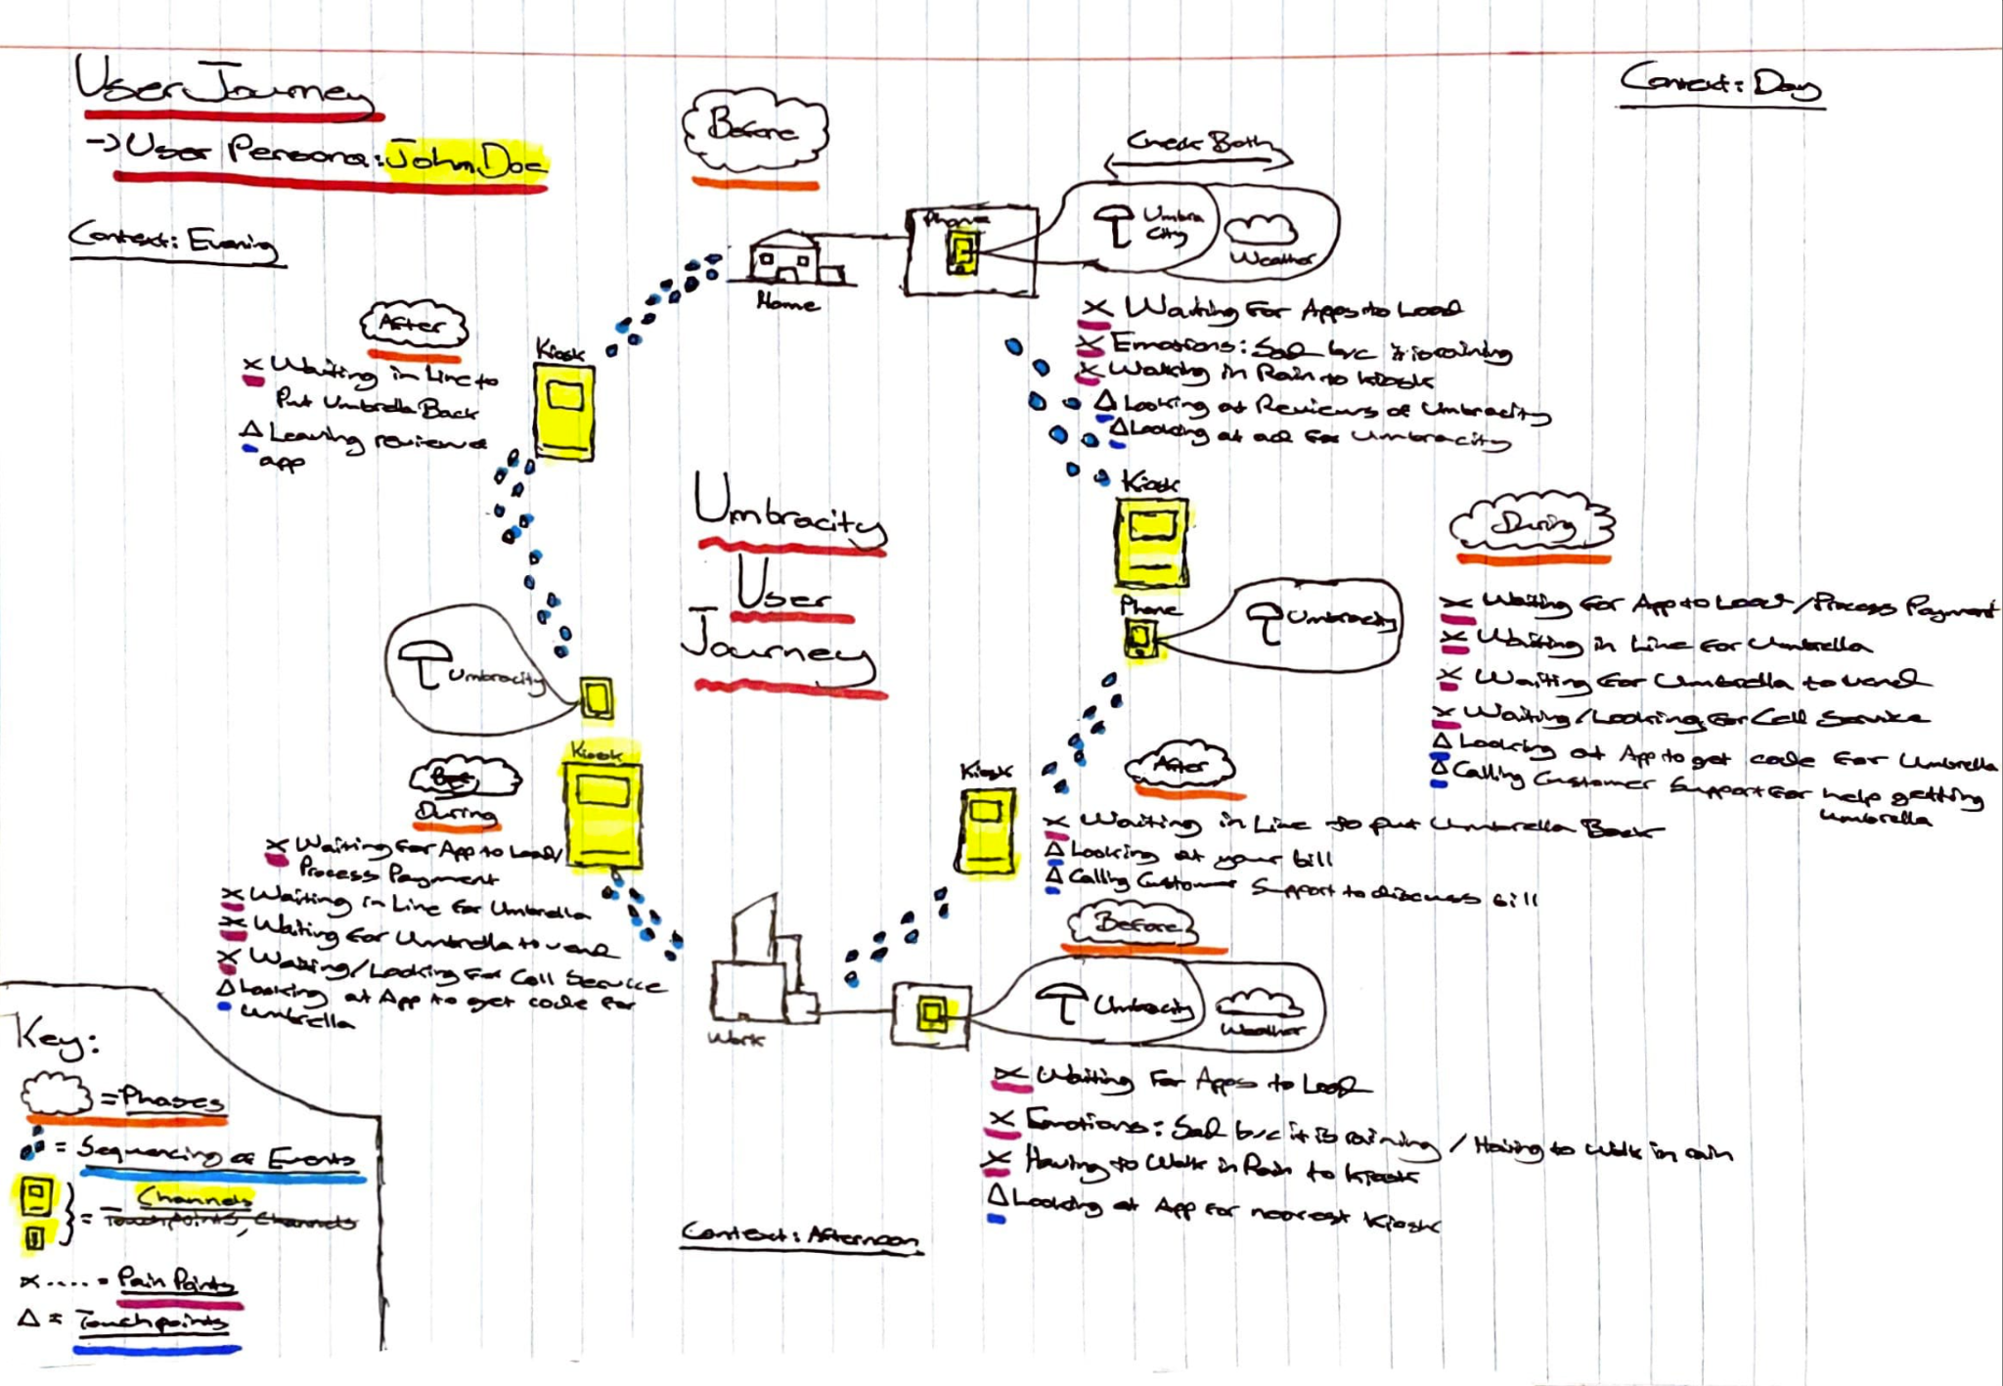
Example User Journey
Channels: Personal laptop
User steps:
User navigates to Craigslist.com
User looks for a search radius to search for
User searches for sneakers to buy
Pain Points:
Difficulty navigating the home page
Struggles to change search location to his hometown
Touchpoints:
User navigates to search results for the sneakers in his hometown
Selects a pair that he likes
Contacts a seller to make a payment
Notes:
Dean

Slide 7
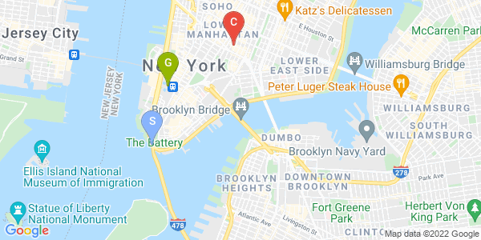
Investigation/Analysis
Created a concrete use case and cognitive walkthrough along with interviewing users
Found through interviewing users that they all had trouble figuring out how to change search location
Cognitive walkthrough and concrete use case helped guide users
Notes:
Dean

Slide 8
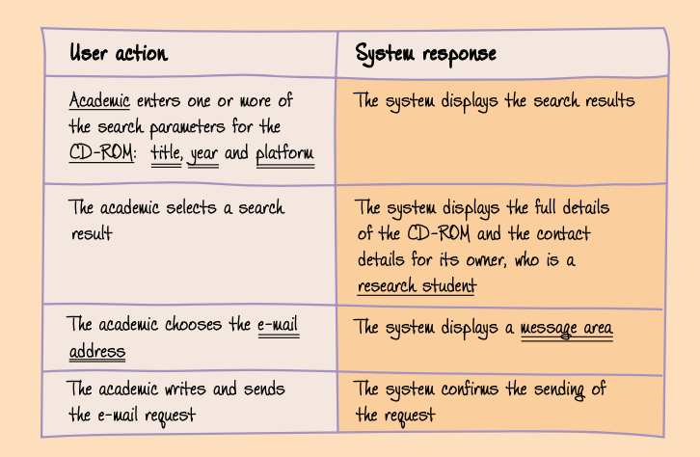
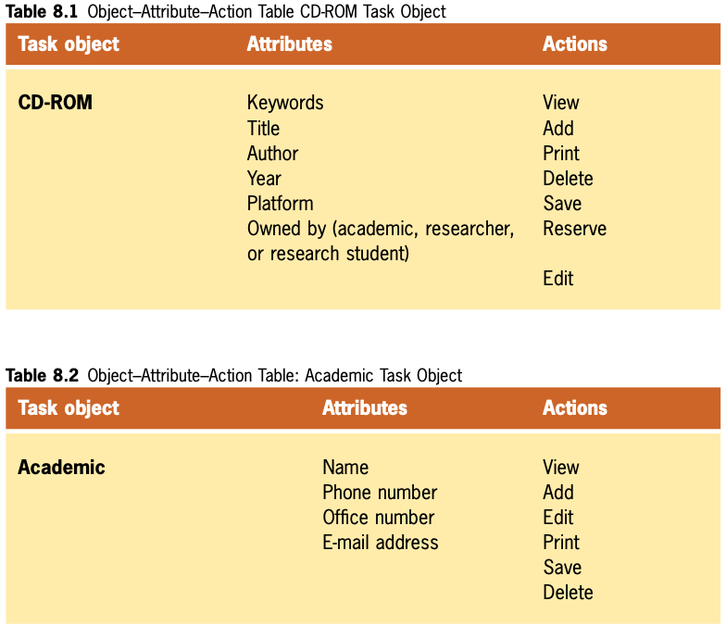
Conceptual Design
Low-Fidelity prototype
Helps to identify what functions the screen should support before building the layout of a design
Concrete Use Case
Object-Attribute-Action Table
Content Diagram: Represents the underlying organization and structure of the UI
Made up of Containers, Links, and functions of objects
Diagram varies from final UI
Notes:
Dean

Slide 9
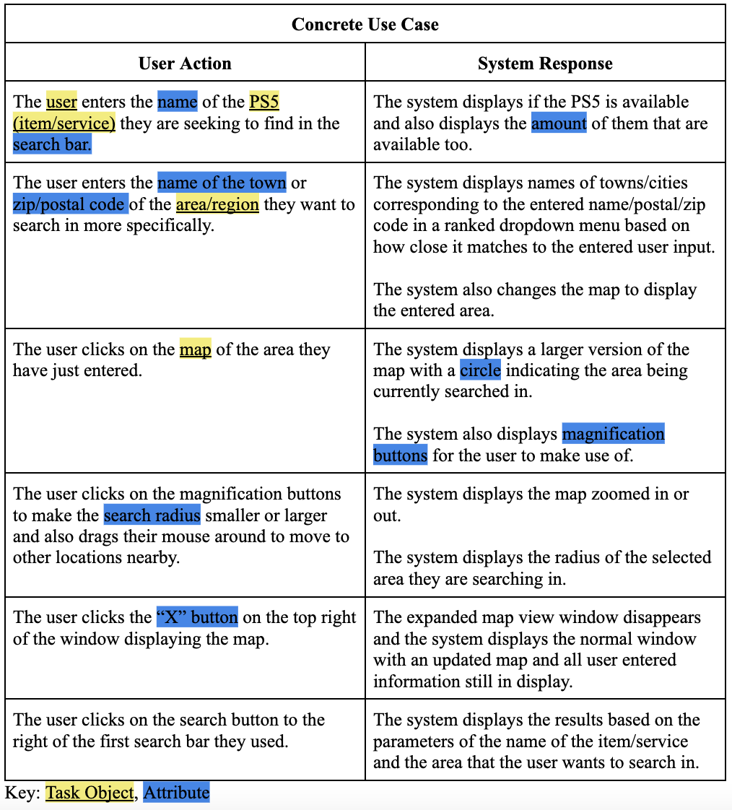
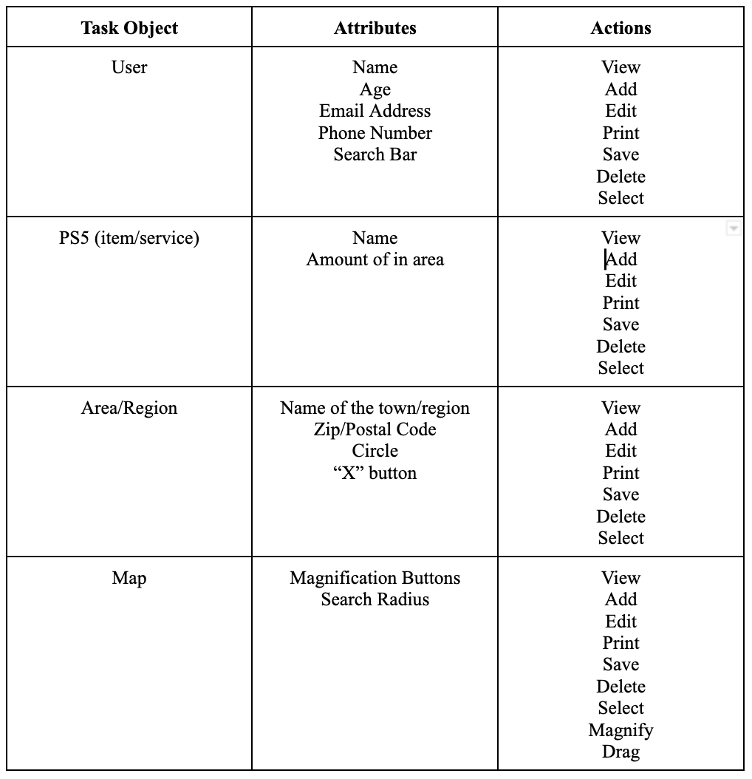
Conceptual Design
Notes:
Dean

Slide 10
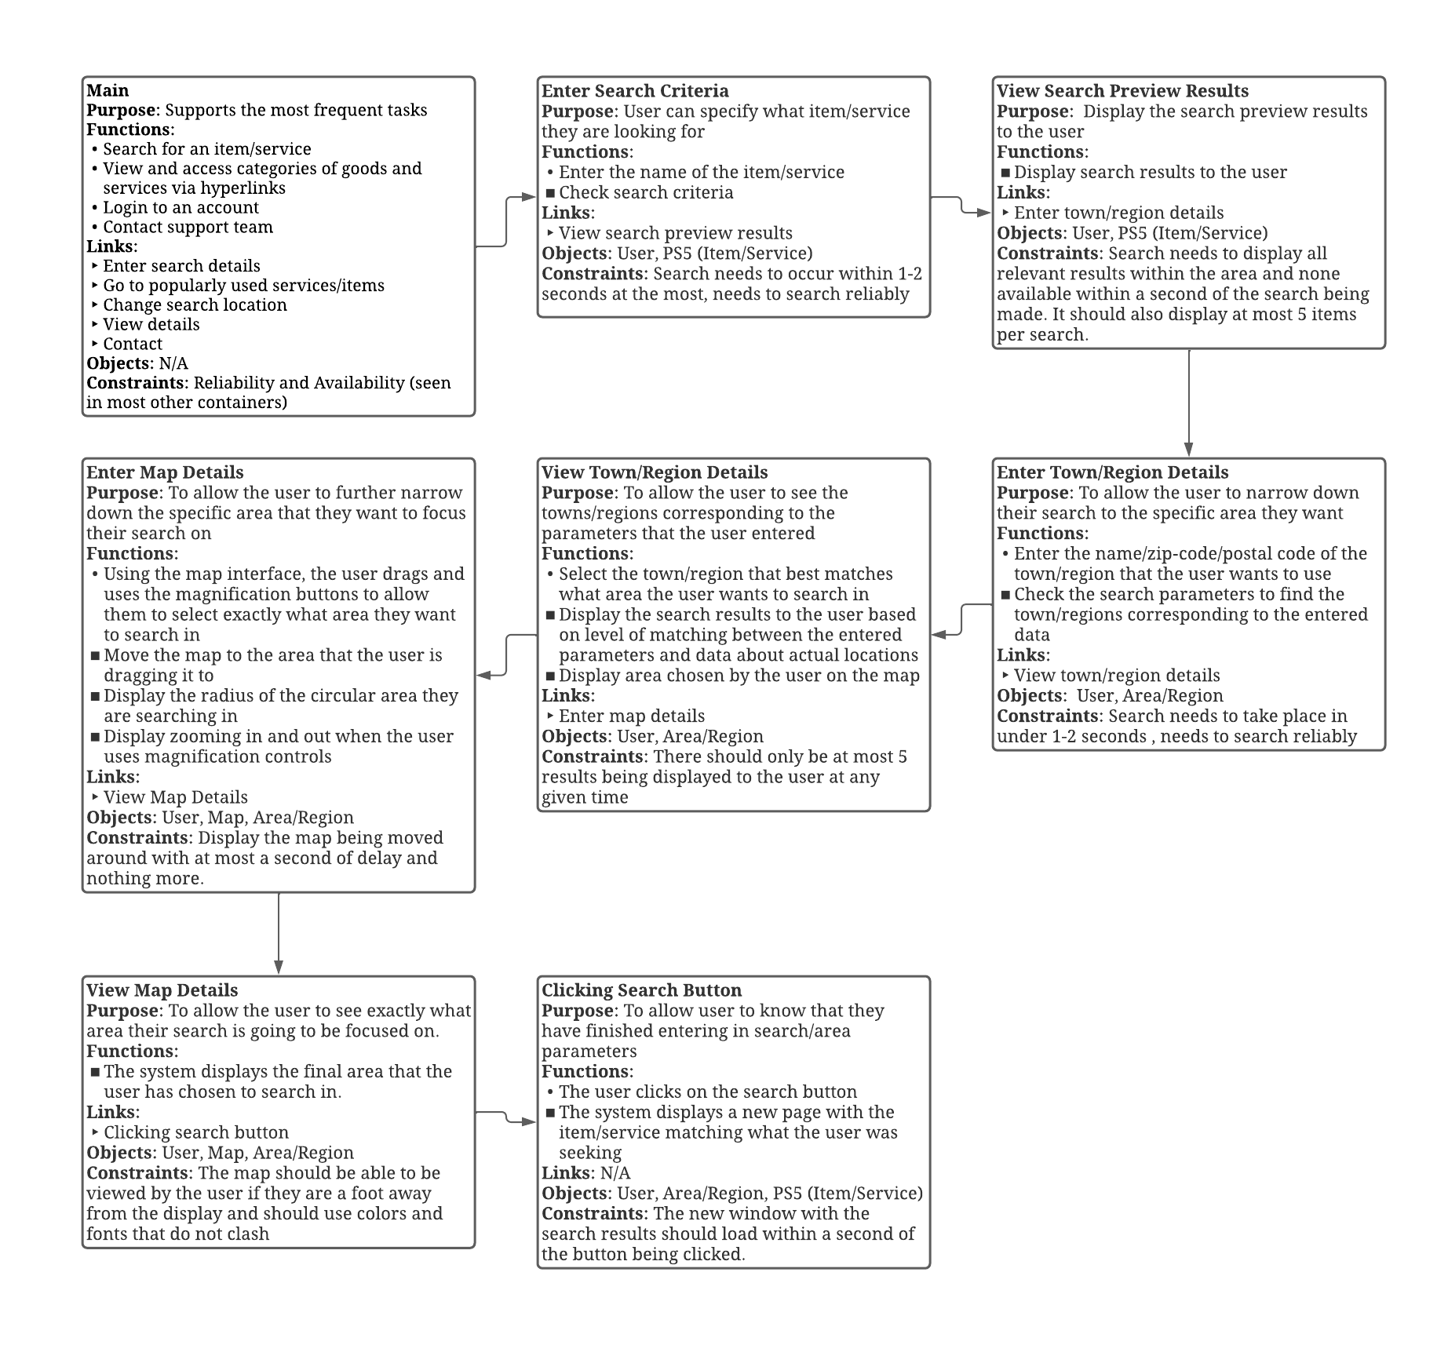
Conceptual Design
- Content Diagram
Displays the actions that a user would take within our newly redesigned system and the system responses
Highlights the following:
How the user of our system would proceed from the main page of our website to then entering in search parameters
Viewing the results to then entering in the general area
Making use of the map to further narrow down the search parameters
Notes:
Dean

Slide 11
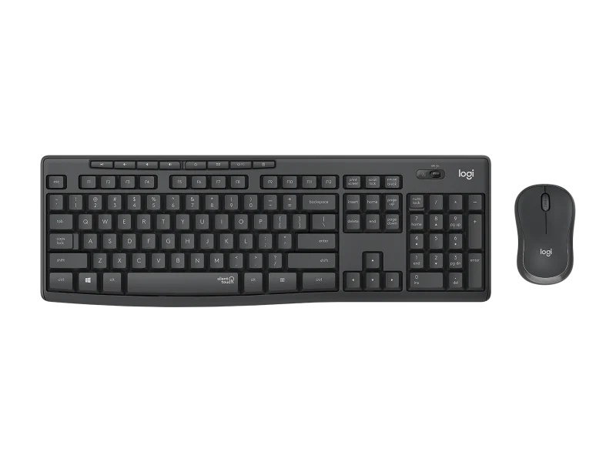
Interaction Styles, Elements. and Devices
We chose to use the interaction devices of keyboard and mouse/mousepad
The site can also be accessed via mobile phone (touch screen)
The keyboard and mouse are familiar to many users. They are very accurate and, as a result, more information can be represented on the screen
Notes:
Dean

Slide 12
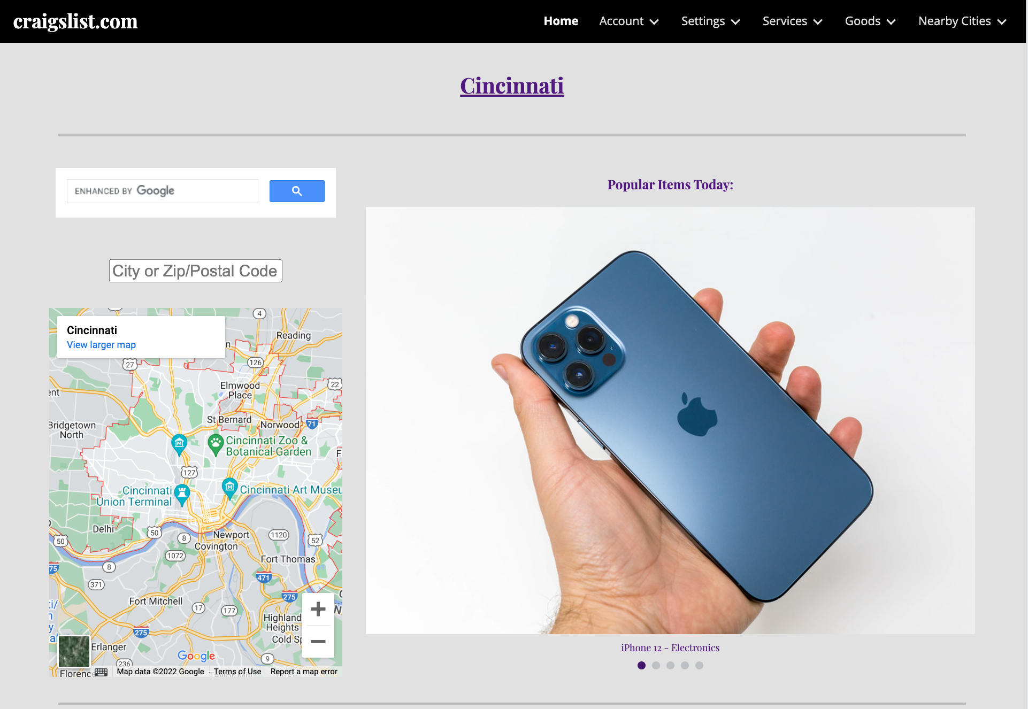
Prototype
We created a high fidelity prototype because that gave us the most leeway when it came to user evaluations
Closer to a final product that is working too
Has many features not on old website
https://sites.google.com/miamioh.edu/craigslist/home
Notes:
Vimal

Slide 13
Evaluation - Cognitive Walkthrough
Had two users in evaluation
1 college aged student from Miami University
1 Middle Aged Man
Field study - dorm and home office
Cognitive Walkthrough:
Used two users - 1 college and 1 middle aged man
Found that they could both do task
Middle aged man slower to finish - not by much though
Notes:
Vimal

Slide 14
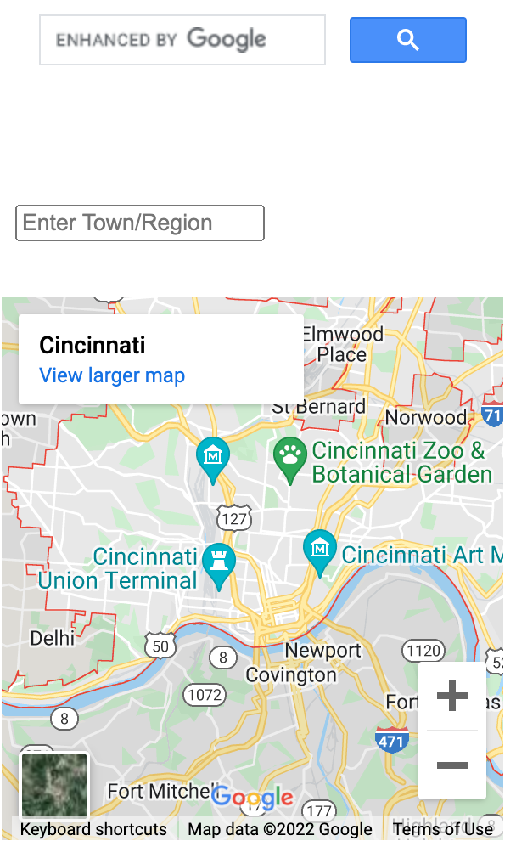
Evaluation - Cognitive Walkthrough Cont.
Found that both users did not think that there were any serious issues with the new UI in terms of completing subgoals
Example: Changing map
Old UI - Hard to find and change
New UI - Easy to find and change
Notes:
Vimal

Slide 15
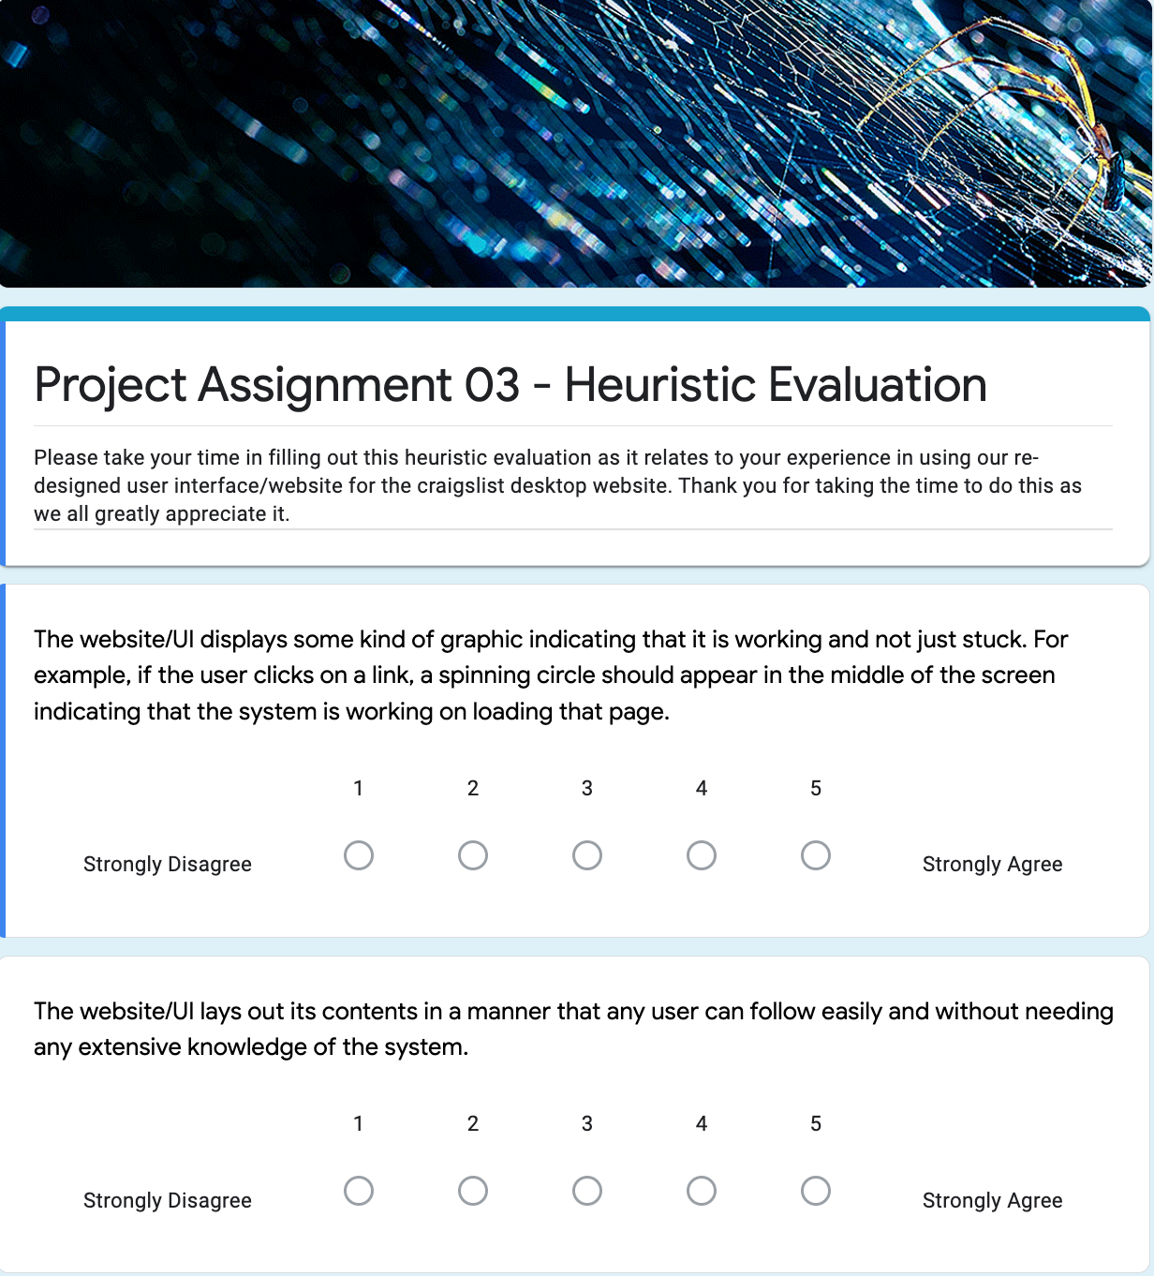
Evaluation - Heuristic Evaluation
Conducted heuristic evaluation on all 3 users
Majority found that the new UI had no issues for 6/10 of the principles of Nielsen’s Heuristic Evaluation Guidelines
Only major issue had to do with design of subpages being not consistent throughout and error messages not displayed
Notes:
Vimal

Slide 16
Lessons Learned - Challenges
Coordination outside of class was one of our biggest challenges
Another challenge we faced was making sure that we completed our work on schedule
Another challenge was making sure we answered all questions thoroughly
Another challenge was with user testing and interviews
Notes:
Vimal

Slide 17
Lessons Learned - Favorite Experiences
Creating the new UI was interesting - especially the coding of the custom google search engine
Interviewing the users, though challenging, was also fun
Finishing our assignments were also fun because they could be very long
Comparing our new UI to the old was fun too
Notes:
Vimal

Slide 18
Thank You! Questions?

